Slide 1


Linux
Presentado por: Luis Palomino

Slide 2
Descripcion General
Que es Unix/Linux?
Historia de Linux
Características compatibles con Linux
El futuro de Linux
Notes:
If you are here you probably wonder about what is Linux and if it will be a good idea to switch to use Linux instead of Windows.
Today class is an introductory class for Linux. Class following this one will be hands on Linux introduction.

Slide 3
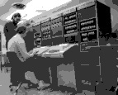
Before Linux
En la Decada de los 80’s, El DOS de Microsoft dominaba el Sistema Operativo para PC.
Apple MAC era mejor, pero el costo era alto
UNIX era un mejor pero mas caro que los 2 anteriores, Solo se usaba para minicomputadoras y aplicaciones comerciales.
Los usuarios buscaba sistemas basados en UNIX, algo mas barato y se pueda ejecutar en las PCs
DOS, MAC and UNIX fueron CopyRigth su codigo fuente y su nucleo estaba protegido.
No permitian modificacion es posible sin tener que pagar altas tarifas de licencias.

Slide 4

GNU project
-Establecido in 1984 por Richard Stallman, que cree que el software debe ser libre de las restricciones contra la copia o la modificación con el fin de tomar mejores y eficientes programas de ordenador.
GNU es un acrónimo recursivo para "GNU No es Unix"
Apunta a desarrollar un sistema operativo completo tipo Unix libre para la copia y modificación
Las empresas pueden hacer dinero mediante el mantenimiento y la distribución del software, por ejemplo, envasado de manera óptima el software con diferentes herramientas (Redhat, Slackware, Mandrake, SuSE, etc)
Stallman construyó el primer libre GNU C Compilador en 1991. Pero aún así, un sistema operativo aún estaba por desarrollarse

Slide 5

Inicios de Linux
El Profesor Andrew Tanenbaum desarrolló Minix, una versión simplificada de UNIX que se ejecuta en PC.
Minix fue sólo para la enseñanza de clases. Sin fines de lucro.
En septiembre 1991, Linus Torvalds, un estudiante de segundo año de Ciencias de la Computación en la Universidad de Helsinki, desarrolló el kernel preliminar de Linux, conocido como Linux versión 0.0.1

Slide 6
-Linux esta siendo utilizado para muchas plataformas de computación: PC, PDA, SMARTPHONE superordenador, ...
-No sólo la interfaz de usuario de caracteres, la interfaz gráfica de usuario tambien está disponible.
-Los distribuidores comerciales movieron por sí Linux para proporcionar el código libremente distribuido. Ellos hacen su negocio, mediante la compilación de varios software y consolidar r en un formato distribuible para ciertos usos,
Red Hat, Slackware, BackTrack etc.
Linux en el presente

Slide 7
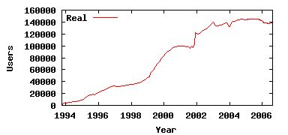
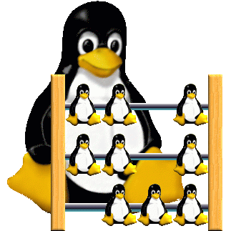
Linux sigue aumentando…
Cada dia se amplia la difusión de su sistema operativo, Linux el código fuente abierto al público. A finales de 1992 había cerca de un centenar de desarrolladores de Linux. El próximo año hubo 1.000. Y los números multiplicados cada año.
Linux: No of Users
Source: The Linux Counter
Según estimaciones recientes, dicen unos 29 millones de personas usan Linux en todo el mundo. Los efectos de la caída de las punto-com, TI desaceleración y la recesión económica mundial se puede ver claramente.

Slide 8
Linux – Software Libre
El software libre, según lo definido por la FSF (Free Software Foundation), es un "asunto de libertad, no de precio." Para calificar como software libre para los estándares de la FSF, debe ser capaz de:
- Ejecute el programa para cualquier
propósito que usted desea, en lugar de
limitarse a lo que puede utilizarlo.
  Ver los programas de codigo abierto.
- Estudie el código fuente del programa y
modificarlo si lo necesita.
- Comparte el programa con los demás.
-Mejora el programa y liberar esas mejoras para que otros puedan usarlos.

Slide 9
Red Hat Linux :Una de la distribución original de Linux.
La versión no libre comercial es Red Hat Enterprise Linux, que está dirigido a las grandes empresas que utilizan los servidores y equipos de escritorio Linux en una gran forma. (NJIT) Proyecto.
Debian GNU/Linux : Una distribución de software libre. Populares para su uso en servidores. Sin embargo, Debian no es lo que muchos considerarían una distribución para los principiantes, ya que no está diseñado con la facilidad de uso en mente.
SuSE Linux : Fue adquirido por Novell. Esta distribución es principalmente disponible para el pago, ya que contiene muchos programas comerciales, aunque hay una versión gratuita despojada que puede descargar.
Mandrake Linux : es tal vez más fuerte en el escritorio. Originalmente con sede fuera de Red Hat Linux.
Gentoo Linux : Gentoo es una distribución especializada destinada a los programadores.

Slide 10
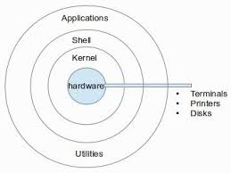
COMPONENTES
DEL
SISTEMA OPERATIVO
LINUX

Slide 11
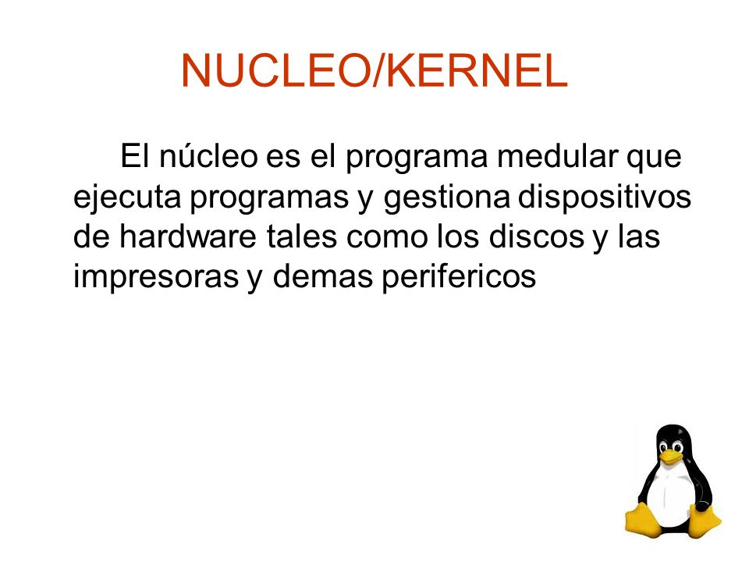

Slide 12
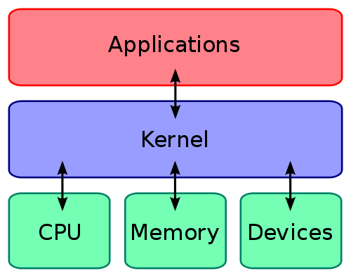

Slide 13
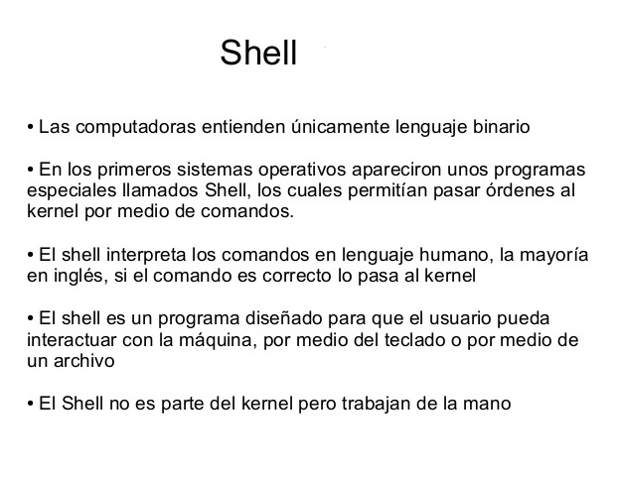

Slide 14
Linux Shell
whoami
Shell Interprete de comandos y servicios del kernel
- Similar que el MS DOS pero tiene
sólo un conjunto de interfaz,
mientras que Linux puede
seleccionar diferentes shell
  Bourne Again shell (Bash), TC shell (Tcsh), Z shell (Zsh)
ls
pwd
Bash, Tcsh, Zsh
Kernel
Different shell has similar but different functionality
Bash es el shell por defecto en Linux
Graphical user interface of Linux is in fact an application program work on the shell

Slide 15
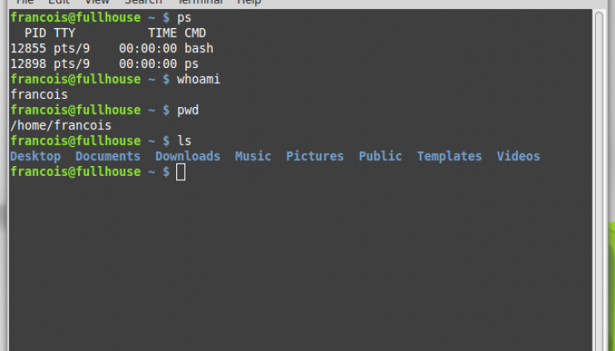

Slide 16
Sistemas de Archivos
Es la forma como esta organizada
la estructura de directorios
del sistema de Archivos

Slide 17
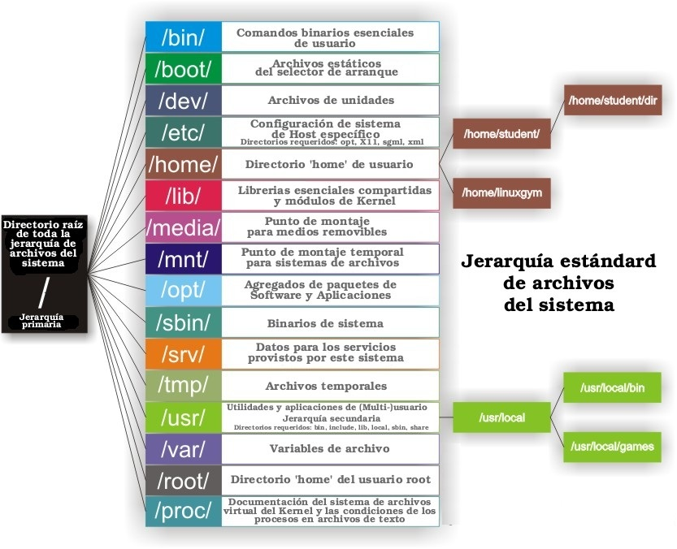

Slide 18
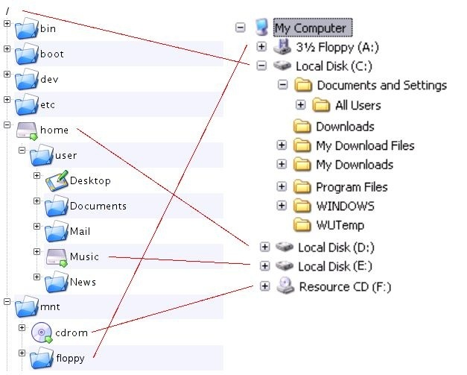
Linux Windows

Slide 19
Distribuciones Linux
http://www.linux.org/dist/list.html
http://CentOS.org
http://fedora.redhat.com/

Slide 20
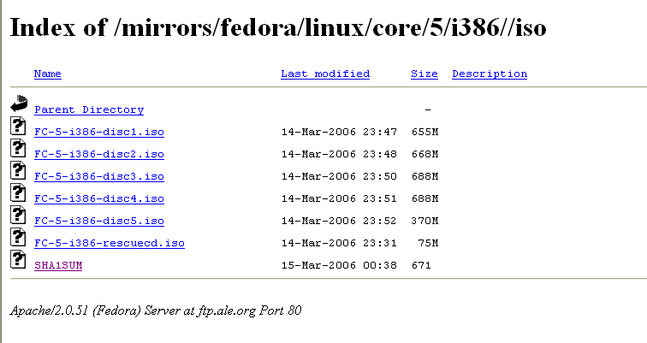
Fedora Core
Fedora Core is a free operating system
http://ftp.ale.org/mirrors/fedora/linux/core/5/i386//iso/

Slide 21
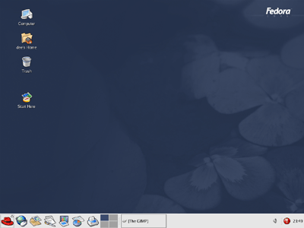
Otras Distribuciones:
Debian
Mandrake
SuSE
El escritorio de Linux
Hay dos grandes equipos de escritorio en el mundo Linux: Gnome y KDE. Lo que estamos viendo en una instalación por defecto de Fedora es una versión personalizada en Red Hat de GNOME, llamado Bluecurve GNOME.
Notes:
Along the bottom of your screen is the panel , which contains many interesting features. Starting at the far left, there's that lovely red fedora, which is the icon for your main menu. Click it, an
To the right of the main menu is a collection of icons, shown in Figure 3-2, that opens popular applications.

Slide 22

Procesador Textos : OpenOffice.org Writer
Email: XimianEvolution
Navegador Web: Mozilla Firefox
Software de Presentaciones: OpenOffice.org Impress
Notes:
Evolution: A Microsoft Outlook-like program combining e-mail, calendar, task manager, address book, and more.

Slide 23
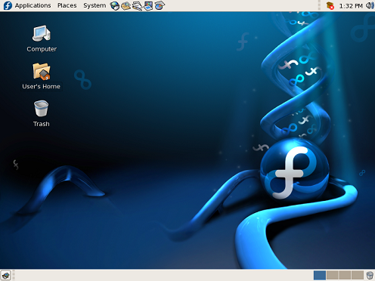
Default Fedora Desktop
El escritorio por defecto tiene tres zonas diferenciadas. De arriba a abajo, las áreas son:
El panel del menú
El área de escritorio
El panel de lista de ventanas
Notes:
The layout location of these items can be customized, but the term used for each of them remains the same.
The menu panel stretches across the top of the screen. It contains three menus and a number of default icons that start software applications. It also provides a clock, volume control applet, and a notification area.
The desktop area is the screen space between the menu panel and the window list panel. The Computer, Home Directory, and Trash icons are located in the top left corner of this area. Those users more familiar with Microsoft Windows may equate these icons to the My Computer, My Documents, and Recycle Bin, respectively.
The window list panel is located at the bottom of the screen. It features the Show Desktop icon, running applications as icons, and it gives access to the workplace switcher and the trash.

Slide 24
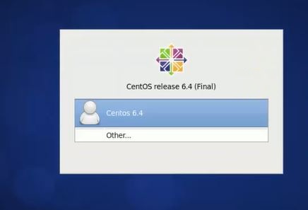

Slide 25
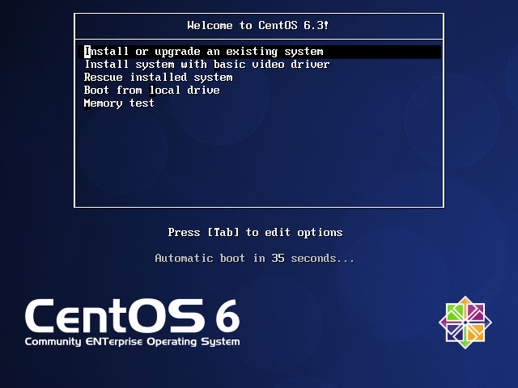
Notes:
AbiWord – Word processor
AddressBook
Calendar
Dia- linux Visio
Emacs – text editor
Gedit – like notepad
Gnumeric - spreadsheet
Nautilus – file manager
Timetracking tool

Slide 26
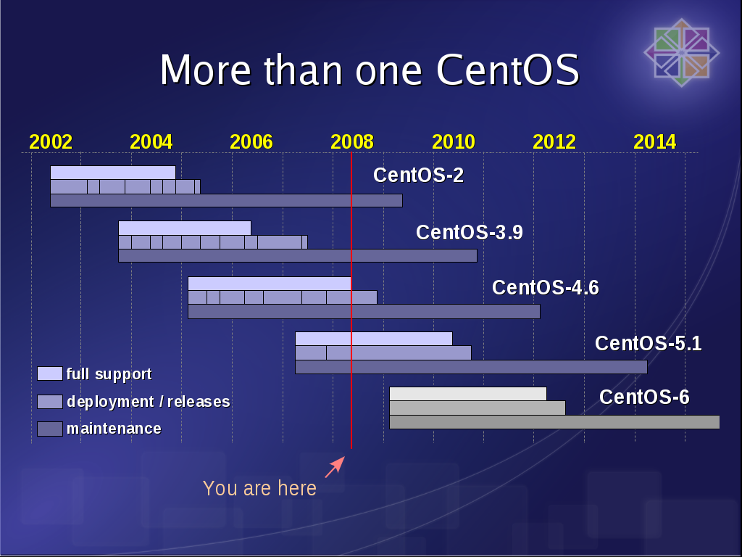

Slide 27
Office Software
word processor,
spreadsheet,
presentation and
database application
Notes:
There are a variety of office type applications for GNU/Linux, but one of them stands alone. The defacto, full-featured, office suite is called OpenOffice.org. 'Openoffice.org' :
word processor,
spreadsheet,
presentation and
database application
OpenOffice.org is completely compatible with many other office suites, including Microsoft Office.

Slide 28
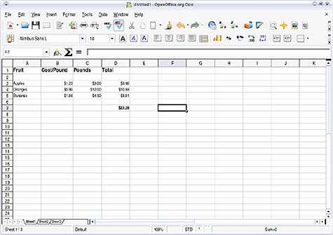
Calc

Slide 29
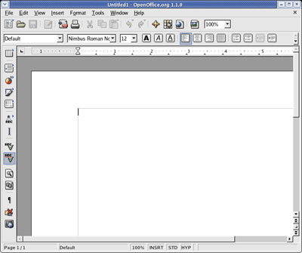
Writer

Slide 30
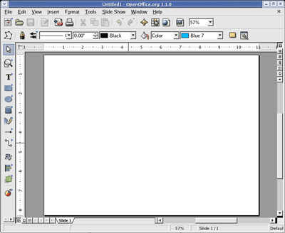
Impress

Slide 31
MS Outlook
Ximian Evolution
KMail
Notes:
There are many e-mail applications for GNU/Linux. However, one of the full-featured suites including a calendar, to do list and e-mail is Ximian Evolution. Ximian Evolution is a powerful and flexible personal information manager up to par with Outlook. Again, it's free, and the interface is designed to look similar to Outlook so the learning curve is low.

Slide 32
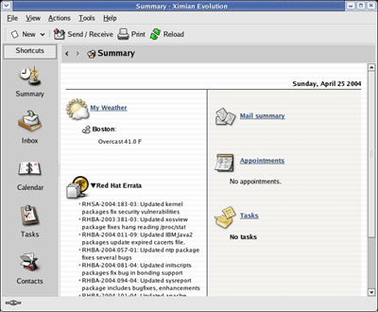

Slide 33
Web Browser: Firefox
Notes:
Most, if not all, distributions come with a Web browser installed and ready to use. Distributions that come with the KDE desktop environment generally come with Konqueror and distributions that come with the Gnome desktop environment generally come with Firefox. Konqueror is the central workhorse of the KDE desktop. Not only is it a Web browser, but it is also a file manager, an FTP client and a plethora of other things. Firefox is available for Windows, as well as GNU/Linux, so it's possible to try out the Windows version before switching over to GNU/Linux to ensure that it will be suitable for you. Oh, and they're all free as well. Other Web browsers you can try are Flock and Opera.

Slide 34
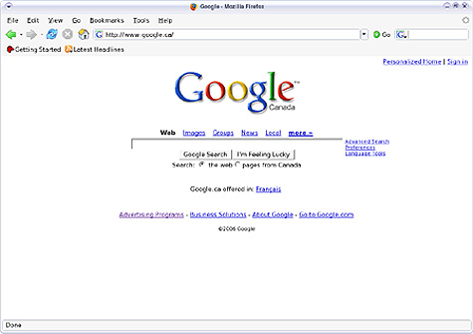

Slide 35
OOo Draw: Drawing

Slide 36
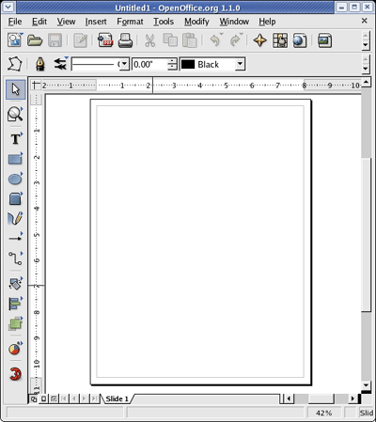

Slide 37
Otros software instalados
Audio Player: El XMMS (X Multimedia System), que se utiliza para reproducir archivos de sonido digital
CD Player: CD player por default
Sound Juicer CD Ripper: Quemar tus propios CDs
Messaging Client: GAIM soporta AIM, MSN, ICQ, y muchas otras redes de mensajería instantánea populares
VSFTP: Útil para el acaparamiento de archivos a través de FTP (File Transfer Protocol)

Slide 38
Administrador de Archivos

Slide 39
Home directory
Tu puedes acceder a tu directorio de inicio
pwd (Mostrar el directorio de trabajo actual)

Slide 40
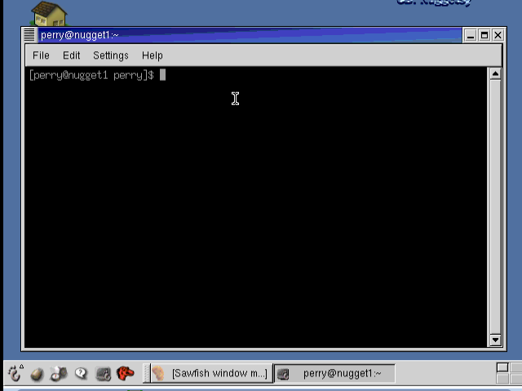
Algunos de los comandos básicos que usted debe aprender son los que le ayudan a navegar el sistema de archivos.
Commands:
/ (root directory)
/root – home directory del usuario root
pwd – Muestra el directorio de trabajo
df – Espacion en disco disponible
cd – Cambia de diferemte directorio
.. - mover al directorio anterior
ls – listados de comandos; Opciones: -l (more info)
-a (displaya archivos ocultos )
-t (sort ea por hora y fecha)
-r (oldest first)
Ejemplo : ls –ltr : muestra el tamaño de la lista de archivos y lo sortea por fecha y hora y muestra del ultimo al primero.
Notes:
Standard way of interacting with linux. Will work with all version of Linux.
X windows: GUI in linux.
pwd – print working directory
/home/perry (you see working directory)
perry@nugget1 – what user you logged in as and what machine you logged into
ls – list the contents of the directory
cd – change directory
cd.. - Moves you to the previous directory
Tab on the keyboard will complete the command
cp – copy
UP arrow on your keyboard is the history command. It will allow you to go back to the previous command.
clear – clears the screen.
rm – remove file “– i” inquire to make sure we want to remove this file
y or yes – it will do it
mv – moves file from one name to the different one
mkdir – make directory
rmdir – to remove empty directory
ls – F – to classify files in a directory
ls – l – see more complete list of the directory’s contents
ls – a – list all the files in a directory, including hidden
ls – t – sorts by time
ls – r – reverse the oldest files first
Directory: /
Executable program: *
Hidden file: .
Metacharacters:
?
[] matches any on of the characters that are enclosed in the brackets
With [] to indicate range of characters
^ (circumflex) (caret) used as the first character in the bracket, it matches any character not in the list.
Ls b[^a,f]g display any file that begins with b and ends in g and where the second letter in the text string is neither an “a” nor an “f”.
Grep “^on” * |* all the files in your home directory are searched for any occurrence of the letters “on” at the beginning of a line
To move file content to another file: cat <fileneame> <filename> > <filename>

Slide 41
  cp : copy one file to another
  rm : remove a file
  man : ask for the manual (or help) of a command
    e.g. man cd ask for the manual of the command cd
  cat : to show the content of a text file
    e.g. cat abc.txt show the content of abc.txt
  whoami : to show the username of the current user
Directory is denoted by a / (slash) character
Executable program by a *
Hidden file preceded by a . (dot)

Slide 42
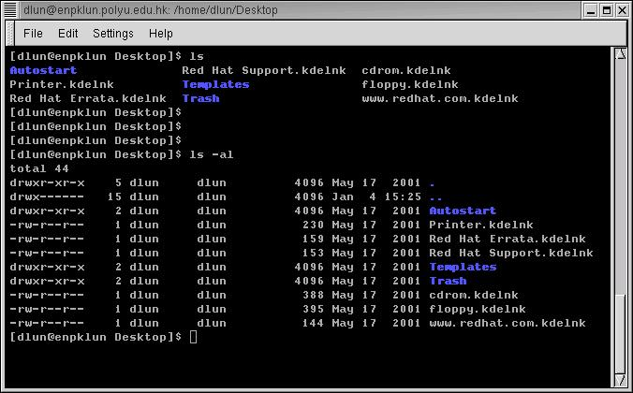
El concepto de simple archivos y directorio similar al DOS
Nombres de Directorios en azul
indicados por una letra d al inicio de la linea.

Slide 43
Editores de Textos
VI editor
Emacs

Slide 44
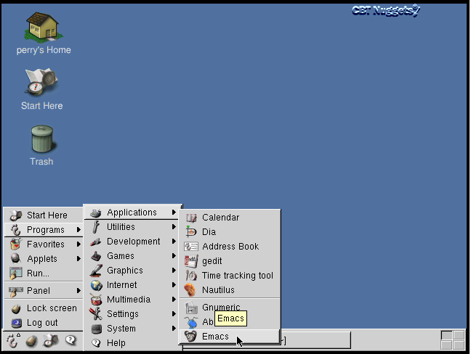
http://www.linux.ie/newusers/beginners-linux-guide/
Notes:
Emacs and Vi (Vim) have long been the two most popular editors on the Linux platform.
You need some knowledge of how to use this editors, even if you will use more advanced GUI application software in Linux. This is because like Vi, the keyboard shortcuts are nothing at all like the ones people may be used to from Windows or a Linux GUI, where Ctrl-c copy's, Ctrl-v pastes and Ctrl-s saves.

Slide 45
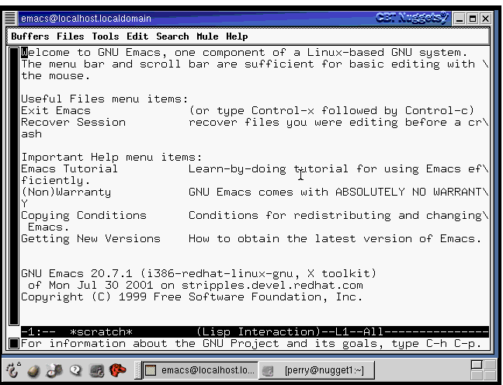
Notes:
To start you can open the terminal and type: emacs
To exit: C-x, C-c This means hold down the Control(Ctrl) key, press x and then hold the Ctrl key and press c. You can hold down the Ctrl key through the entire operation or let go after C-x and treat C-c as a separate command — it makes no difference.
Files
To open a file in Emacs do C-x C-f. You will be prompted for the name of the file to open. Note that you will need to specify the exact name and path of the file for emacs to open it — no fancy Browse buttons here. If you specify a file name that doesn't exist, Emacs will create it in the current directory. Probably the easiest way to open a file is to specify it when starting Emacs.
For example $emacs -nw myfile opens the file called myfile in the current folder. Again, if the file doesn't exist Emacs will create it. If you open a file and find the content has disappeared since you last looked at it, don't panic, you probably mistyped the name!
Navigation
As with most other text editors you can navigate around a file using the arrow and page up / page down keys. However you should know that it is also possible to do this with Emacs command, which often provide much finer grained control and can save you a lot of key bashing to get around:
C-f Move forward a character C-b Move backward a character M-f Move forward a word M-b Move backward a word M-a Move to beginning of sentence M-e Move to end of sentence C-n Move to next line C-p Move to previous line C-a Move to beginning of line C-e Move to end of line
Other important commands
To save the file you are currently working on do C-x C-s.
To undo your last move do C-x u
Another important command for beginners is C-g. Sometimes you may accidentally enter some command or emacs prompts you for something you don't understand or want to know about emacs will just drop whatever it was asking you about or doing and let you get on with it.
To delete a word do M-d and to delete a line do C-k. Both of these commands can save a lot of key bashing. They will however only delete text to the right of the cursor.
Summary
Knowing how to find your way around Emacs can save you a lot of grief when trouble strikes and its definitely worth it to use emacs for a while even if other easier to use editors are available. When just starting with emacs it can be a good idea to keep a short list of essential commands handy until you know them off:
C-x C-c Exit Emacs C-x C-f Open a file C-x C-s Save the file C-x u Undo C-g Cancel command/get rid of prompt M-d Delete word C-k Delete line C-f Move forward a character C-b Move backward a character M-f Move forward a word M-b Move backward a word M-a Move to beginning of sentence M-e Move to end of sentence C-n Move to next line C-p Move to previous line C-a Move to beginning of line C-e Move to end of line

Slide 46
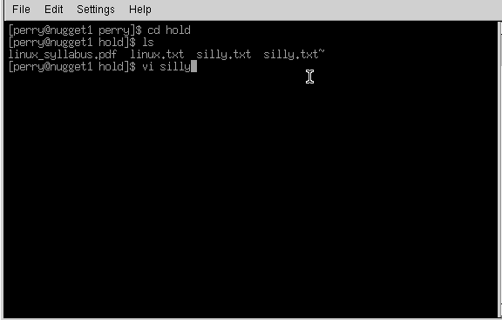
Editor VI
Abre desde la ventana de terminal o una consola CTRL ALT F2,F3 ..F6
Notes:
From the command line, type vi blah
The editor will appear on-screen, with a tilde, ~, on evey line, and at the bottom of the screen it says "blah" [new file]. If you want to put anything into this file, you have to put vi into insert mode. Do this by typing the letter 'i' on its own. "-- INSERT --" appears on the bottom of the screen. Now you can type in anything you want. Try typing "Hello", and then on a new line "World". Now try going back up to the line above, using the cursor keys and try to delete Hello. You wont be able to. When you give a Carraige Return (Press Enter in other words), the text on that line becomes static. If you want to delete it, heres how.
Press your Esc button on the top left of the keyboard, and the "-- INSERT --" at the base dissapears. Vi is ready to accept a new command. The only thing here is that vi will only delete what is in front of the cursor, let me show you. Bring the cursor to the start of Hello, and press the x key once. Now only 'ello' remains. This doesnt really make any sense, so we'll delete the line altogether. Press 'd' twice in quick sucession. Now we have the word 'World' on its own. Press 'i' and insert "Hello" again. This time, leave the text in insert mode. Press the "Insert" key on your keyboard, its above the cursor keys. The "-- INSERT --" at the base of the screen has been replaced with "-- REPLACE --". Now type the word "Nurse" over the existing "World". Press Esc again to return to the ready mode.
Vi has a search tool too, which I find indispensable. From the ready mode, type in a slash, /, and input the text you want to look for. Remember, since Linux is case sensitive, looking for "money" is not the same as looking for "Money".
Well, what about saving the file, or quitting without saving? What about just quitting? Its easy. From the ready mode, type in ":w" to write the file ... you already supplied the file name when you typed 'vi blah' earlier. The editor will return this on the status line : "blah" [New File] 1 line, 12 characters written. Lets quit out of it altogether. Type in ":q“or :quit!. You have been returned to the command prompt. There was an easier way of doing that ... from the ready mode in the editor, you could have just typed in, in cap:itals, "ZZ" ... this saves the file and quits. If you had wanted to quit without saving the changes, you could have just typed in ":q!", and nothing would have saved ... blah wouldn't have existed.

Slide 47
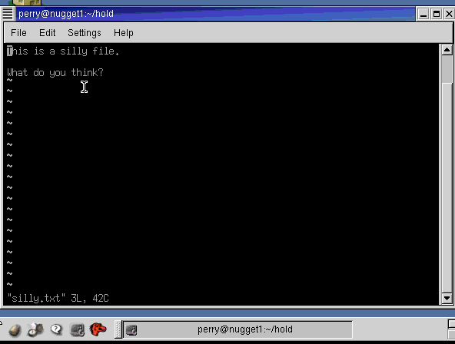
http://www.linux.ie/newusers/beginners-linux-guide/
Notes:
Smaller program, more primitivy.
There are 3 modes:
Command mode
X mode
Edit mode
go into insert mode (by either pressing the letter 'i' or the insert key)
delete text to the right of the cursor one character at a time with 'x'
delete text one line at a time by pressing 'd' twice in quick succession
search for text with '/'
save text to a file (:w) and exit vi (:q or :q! if you don't mind losing changes).
“Exc” key will take you to the command mode.
I – Insert
Esc
Shift “:” and “wq” – write my changes and quit
“dd” delete line of text
“cat” prints file to the screen
Say that again.
You can have a command repeated a number of times by first typing in the amount of times that you want the command to occur so to delete a seven lettered word just type '7x'.
You might wonder about the above line 'delete text to the right of the cursor' - is this excess pedantry or is it leading on to something useful?
The latter applies; pressing 'X' deletes the character immediately to the left of the cursor and typing 7X, for example, deletes any seven characters that are immediately to the left of the cursor.
So what happens if you are at the end of a 21 character line and you type '30X' - do nine charaters of the preceding line get deleted?
No, the above line will remain intact but any the text to the left of the cursor will indeed get deleted.
You can, if you want to, repeat a command just once; by pressing '.', this I suppose could be called the 'redo' button; it has a counterpart ('u') which will undo the last change.
There's more than one way...to delete a word.
Now, just to get back to deleting words. I mentioned that you could use '7x' to delete a seven lettered word. That's all well and good if you don't mind counting off the number of letters in whatever word it is that you want to delete. There's a better way to do this (there's always a better way).
You can delete words with 'dw' and 'db'; use 'dw' for deleting words to the right of the cursor and 'db' for deleting words to the left - and if you want to delete seven words then use '7dw'.
Moving the cursor.
This moves on (hur, hur) rather nicely to the next thing that I want to get to - moving the cursor around. Obviously you can use the cursor keys but there are other ways of doing it.
For example, if you want to move to the start of the previous sentence use '(', if you want to move on to the next one then press ')'. You can go squiggly if you want to move around one paragraph at a time and use '{' or '}' respectively. If you only want move around by a few words then use 'W' and 'B'.
The great thing about all of this is precision.
And I haven't even gotten to the good stuff yet.
Cut & Paste.
Do you remember about 'dd', and that it deletes lines one at a time? Well here's something nifty that you can do with it and just one other command. Let's say that you have a four line block of text that you want to move (be it source code or whatever). Move the cursor to the first line of that block of text and type '4d', then move the cursor to where you want to put the text and type 'p'.
This will put the text you previously deleted back in, after the cursor. Using 'P' will insert the deleted text before the cursor.
Copy & Paste.
So now you know how to cut and paste text in vi.
The next thing to learn is how to copy and paste text and there really isn't anything to it at all; instead of putting text into the memory buffer by deleting it text needs to be put there without deleting it. This is done by yanking the text.
If you want to yank four lines of text into the buffer, move the cursor to the first line of that block of text and type '4Y'. You can then use 'p' or 'P' to place a copy of that text elsewhere.
Other ways to change text.
There are a few other ways that you can use to edit text. If, for example, you have typed in 'ilug' where you meant 'ILUG' you can either press 'R' with the cursor at the start of 'ilug', type the abbreviation in with caps lock on and press ESC to get out of replace mode. Or you can do it quickly by positioning the cursor and then typing '4~'.
And if you want to delete to the end of a line 'D' will work just fine.
Windows.
Sometimes it can be quite handy to have more than one file open in vi at the same time - specifications in one 'window' and the source code in another for example.
To do this you need to have one file open first and then press Ctrl & w (the control and 'w' keys at the same time) followed by 'n'. This will result in a new window created at the top of the screen, with the screen divided equally between the two windows.
To edit a file in this new window you need to type ':e' followed by the name of the file. You can keep on doing this until you have as many files open as is needed.
Moving between the windows is fairly simple. Press Ctrl & w first to let vi know that you want to do something about the windows and then press:
t if you want to move to the top one
b if you want to move to the bottom window
Up arrow or down arrow to move to a window in the middle, you can also use 'j' or 'k' if you don't have any arrow keys for some reason.
Typing ':q' will close the window that the cursor is in, if you want to close all other windows then press 'Ctrl & w' followed by 'o'.

Slide 48


!=
Linux is Not Windows
Problem #1: Linux no es exactamente que Windows.
Problem #2: Linux es totalmente diferente a Windows
Problem #3: Cultura de shock
Problem #5: El mito de "user-friendly"
Notes:
You'd be amazed how many people make this complaint. They come to Linux, expecting to find essentially a free, open-source version of Windows. Quite often, this is what they've been told to expect by over-zealous Linux users. However, it's a paradoxical hope. As a simple example, consider driver upgrades: one typically upgrades a hardware driver on Windows by going to the manufacturer's website and downloading the new driver; whereas in Linux you upgrade the kernel. This means that a single Linux download & upgrade will give you the newest drivers available for your machine, whereas in Windows you would have to surf to multiple sites and download all the upgrades individually. It's a very different process, but it's certainly not a bad one. But many people complain because it's not what they're used to.
But switching from Windows to Linux is like switching from a car to a motorbike. They may both be OSes/road vehicles. They may both use the same hardware/roads. They may both provide an environment for you to run applications/transport you from A to B. But they use fundamentally different approaches to do so.
Windows/cars are not safe from viruses/theft unless you install an antivirus/lock the doors. Linux/motorbikes don't have viruses/doors, so are perfectly safe without you having to install an antivirus/lock any doors.
Linux users are in more of a community. They don't have to buy the software, they don't have to pay for technical support. They download software for free & use Instant Messaging and web-based forums to get help. They deal with people, not corporations.

Slide 49
SSH (Putty, Winscp)
SSH (Secure Shell) es un protocolo de emulación de terminal que permite a un usuario conectarse a un host remoto a través de un enlace encriptado y seguro.
PuTTY es un cliente SSH, Telnet, rlogin, y TCP raw con licencia libre. Disponible originalmente sólo para Windows, ahora también está disponible en varias plataformas Unix, y se está desarrollando la versión para Mac OS clásico y Mac OS X.
Winscp es una aplicación de Software Libre. WinSCP es un cliente SFTP gráfico para Windows que emplea SSH. También se puede seguir usando la versión anterior del protocolo. Su función principal es facilitar la transferencia segura de archivos entre dos sistemas informáticos, el local y uno remoto que ofrezca servicios SSH. .

Slide 50
